Slide 1
Welcome to the coding world!!

Slide 2
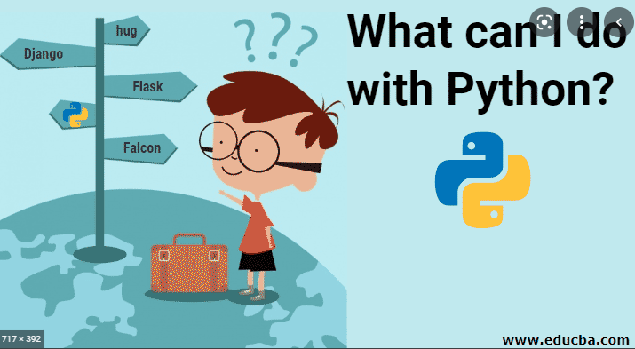

Slide 3
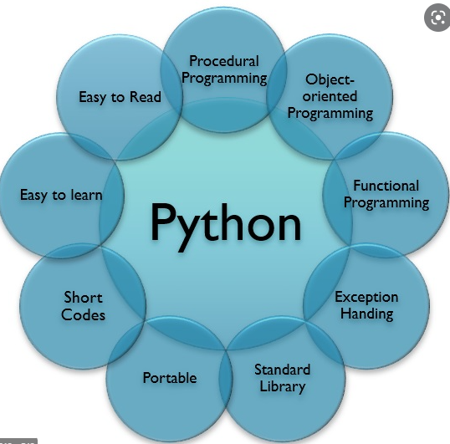
python
1. can help you to do your homework
2. can get data from website
3. create games.
4. data analysis.

Slide 4
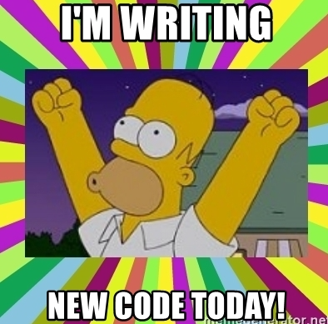
how to learn python?
1. before coding, make your plan
2. make your own tool box
3. coding hard
4. interesting in it~

Slide 5

Variables and type
1. string
“i am homer” “hello”, ‘a’

Slide 6
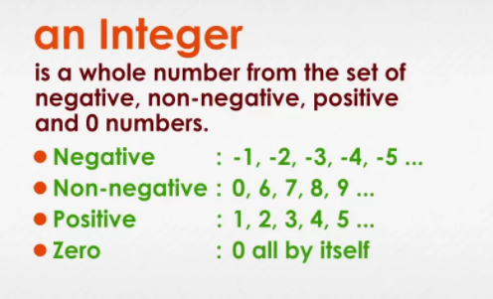
Integer
The number has no
decimal point.
for instance 1,2,3,4,5...,100,

Slide 7
Float
all of the number with decimal point
for instance like:
1.1, 2.5, 3.4, 4.6.....10.0

Slide 8
boolean
True or False.

Slide 9
how to do use python to do your math homewor
1. do plus
2. do minus
3 do multiply
4. do divide.

Slide 10

1. what is List?
list is like your bag which can contain everything inside.

Slide 11
how to add something in the bag?
list.append

